Slide 1

HR Engagement Initiatives for Adventure Works: Strategies, Metrics, and Impact
Enhancing workplace culture through strategic initiatives
Notes:
AI-generated content may be incorrect. --- In this presentation, we will delve into the current employee engagement status at Adventure Works, explore engagement initiatives and strategies aimed at fostering a positive workplace culture, and discuss the implementation plan with timelines and metrics to evaluate the impact of these initiatives.

Slide 2

Agenda Overview
Current Employee Engagement Status
Engagement Initiatives and Strategies
Implementation Plan and Timeline
Notes:
We will first assess the current employee engagement status by reviewing survey results and identifying key metrics. Next, we will discuss specific engagement initiatives and strategies. Finally, we will outline the implementation plan, including timelines and methods for monitoring and evaluation.

Slide 3
Current Employee Engagement Status
Notes:
Understanding the current employee engagement status is crucial for designing effective initiatives. This section will highlight key findings from the recent employee engagement survey.

Slide 4

Employee Engagement Survey Results
Employee Satisfaction Insights
The survey provided detailed insights into employee satisfaction levels across various departments and teams, highlighting key areas of strength.
Commitment Levels
Findings indicate the levels of employee commitment, revealing how invested employees are in their roles and the organization’s goals.
Opportunities for Improvement
The analysis identified key areas where improvements can be made to boost morale and engagement, fostering a more positive workplace culture.
Notes:
The employee engagement survey revealed valuable insights into employee satisfaction, commitment, and overall morale. Key findings indicate areas of strength as well as opportunities for improvement. Analyzing these results helps in understanding the pulse of the organization.

Slide 5
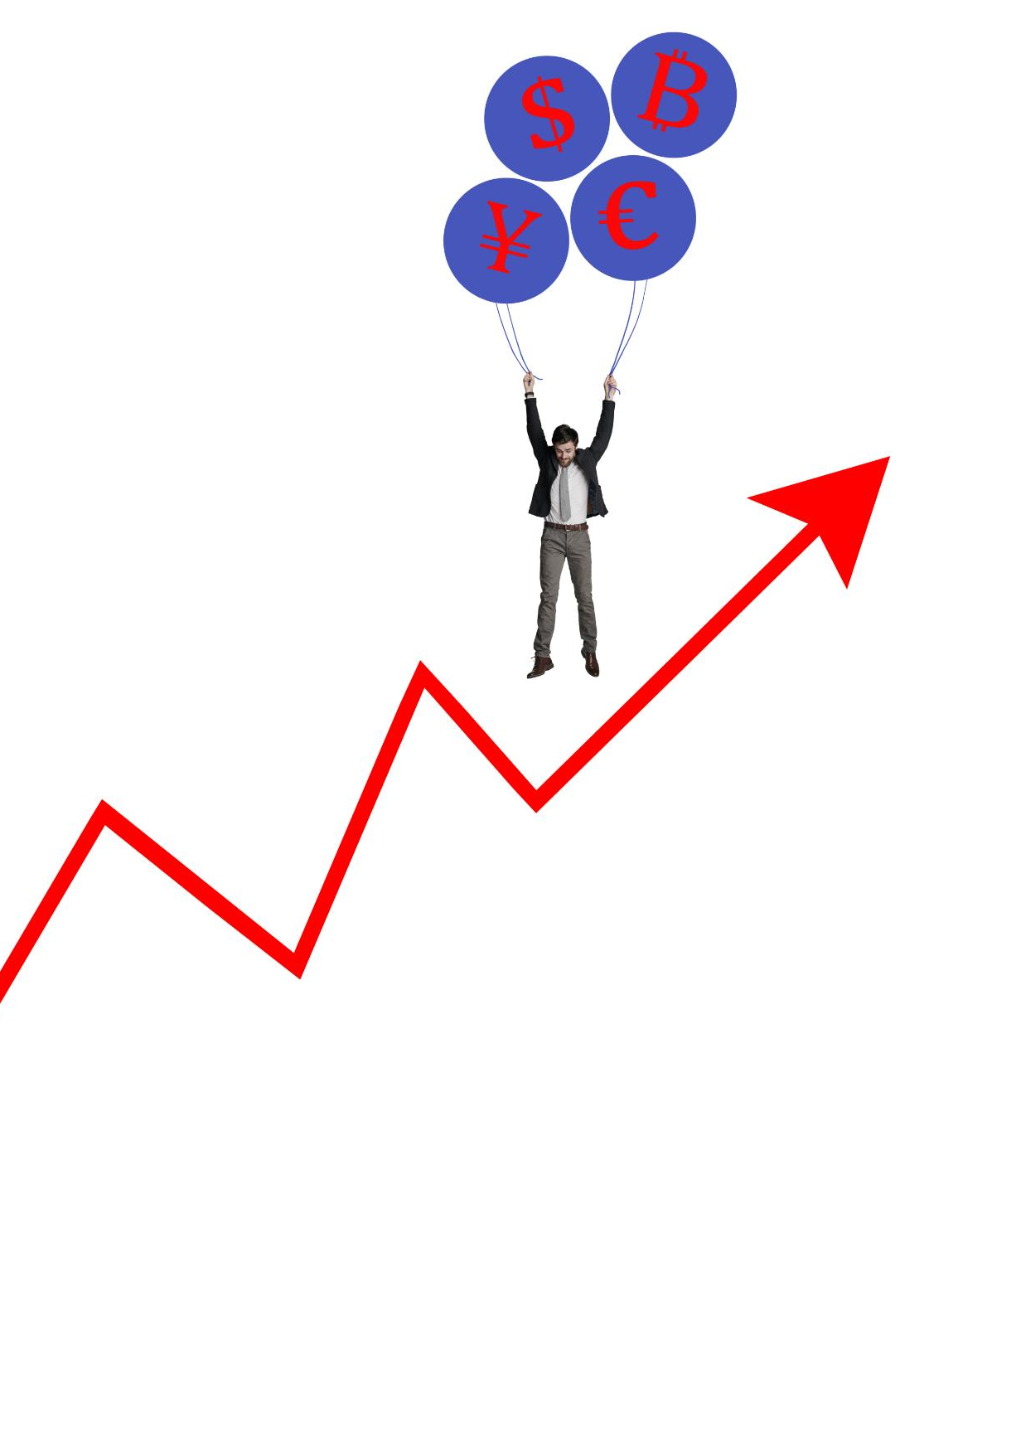
Key Metrics and Statistics
Participation Rates in Surveys
Tracking participation rates in employee engagement surveys is crucial for understanding engagement levels and ensuring comprehensive feedback.
Employee Turnover Levels
Monitoring employee turnover levels helps identify retention issues and evaluate the impact of engagement strategies on staff stability.
Job Satisfaction Scores
Overall job satisfaction scores provide insights into employee morale and the effectiveness of engagement initiatives in the workplace.
Notes:
Key metrics and statistics are essential for evaluating employee engagement levels. This includes participation rates in surveys, levels of employee turnover, and overall job satisfaction scores, which inform the effectiveness of current engagement practices.

Slide 6
Identified Areas for Improvement
Communication Gaps
Survey results indicate significant communication gaps that hinder team collaboration and employee engagement.
Recognition Practices
Improving recognition practices is essential to motivate employees and enhance job satisfaction within the organization.
Professional Development Opportunities
Providing opportunities for professional development will empower employees and foster a culture of continuous learning.
Notes:
Based on survey results and metrics, several areas for improvement have been identified, including communication gaps, recognition practices, and opportunities for professional development. Addressing these will be key to enhancing employee engagement.

Slide 7
Engagement Initiatives and Strategies
Notes:
To improve employee engagement, it is essential to implement targeted initiatives and strategies. This section explores the programs designed to foster a more engaged workforce.

Slide 8

Employee Recognition Programs
Boosting Morale
Recognition programs are essential for enhancing employee morale and creating a positive workplace culture.
Motivation Enhancement
Implementing recognition initiatives motivates employees to perform at their best and fosters a sense of belonging.
Employee Satisfaction
Formal and informal recognition can lead to higher employee satisfaction and improved retention rates.
Notes:
Recognition programs are vital for boosting morale and motivation. Implementing formal and informal recognition initiatives can significantly enhance employee satisfaction, leading to higher engagement levels.

Slide 9

Professional Development and Training
Importance of Development
Investing in professional development is essential for fostering employee growth and enhancing productivity in the workplace.
Boosting Engagement
Providing training opportunities significantly boosts employee engagement and motivation, leading to a more dynamic work environment.
Improving Retention Rates
Effective training programs contribute to higher employee retention rates by fostering loyalty and career advancement opportunities.
Notes:
Investing in professional development and training is crucial for employee growth. Providing opportunities for skill development and career advancement not only boosts engagement but also improves retention rates.

Slide 10

Work-Life Balance and Wellness Initiatives
Importance of Work-Life Balance
A healthy work-life balance is vital for employee well-being and productivity. It helps reduce stress and prevent burnout.
Flexible Work Arrangements
Implementing flexible work arrangements allows employees to manage their time effectively, promoting a better balance between work and personal life.
Wellness Programs
Wellness programs support physical and mental health, enhancing job satisfaction and reducing workplace stress.
Notes:
Promoting work-life balance and wellness initiatives is essential for employee well-being. Implementing flexible work arrangements and wellness programs can aid in reducing burnout and enhancing overall job satisfaction.

Slide 11
Implementation Plan and Timeline
Notes:
A well-structured implementation plan is necessary for the successful rollout of engagement initiatives. This section outlines the timeline and strategic steps for effective implementation.

Slide 12

Phase-Wise Implementation Schedule
Systematic Approach
Dividing the implementation into phases allows for a more systematic and organized approach to project management.
Specific Activities
Each phase includes specific activities crucial for achieving the overall project objectives effectively.
Timelines and Stakeholders
Establishing clear timelines and assigning responsible stakeholders for each phase ensures accountability and timely execution.
Notes:
The implementation schedule is divided into phases to ensure a systematic approach. Each phase includes specific activities, timelines, and responsible stakeholders to facilitate a smooth rollout.

Slide 13
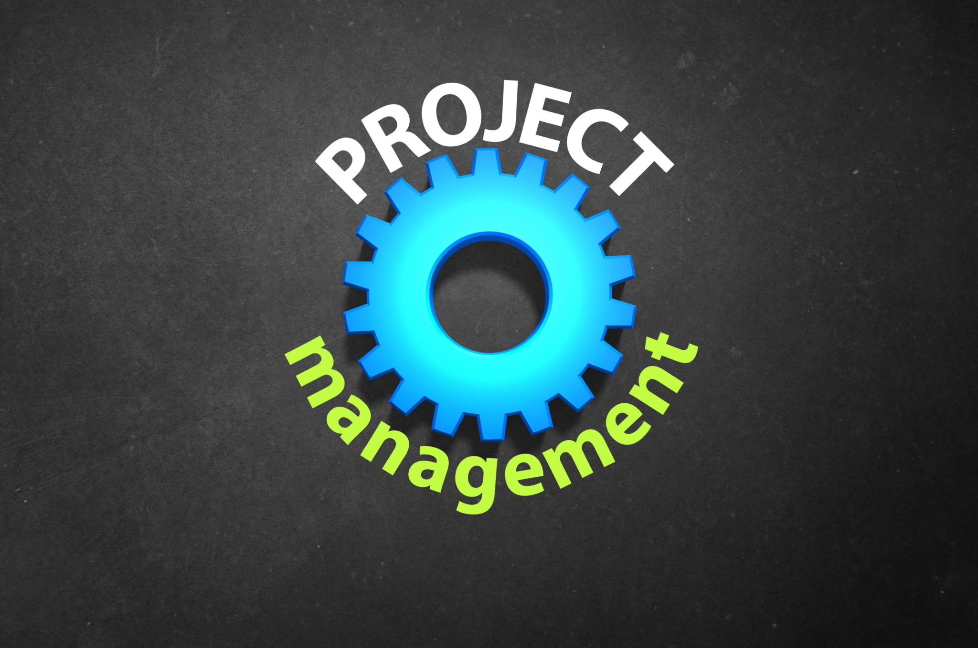
Resource Allocation and Budgeting
Importance of Resource Allocation
Effective resource allocation ensures that both financial and human resources are optimized for successful project initiatives.
Budgeting for Success
Proper budgeting is essential to track expenses and ensure that initiatives are funded adequately for maximum impact.
Allocation Strategies
Identifying effective allocation strategies can enhance the efficiency and effectiveness of engagement initiatives.
Notes:
Proper resource allocation and budgeting are critical for the success of engagement initiatives. This slide will detail the financial and human resources required for each initiative and how they will be allocated effectively.

Slide 14
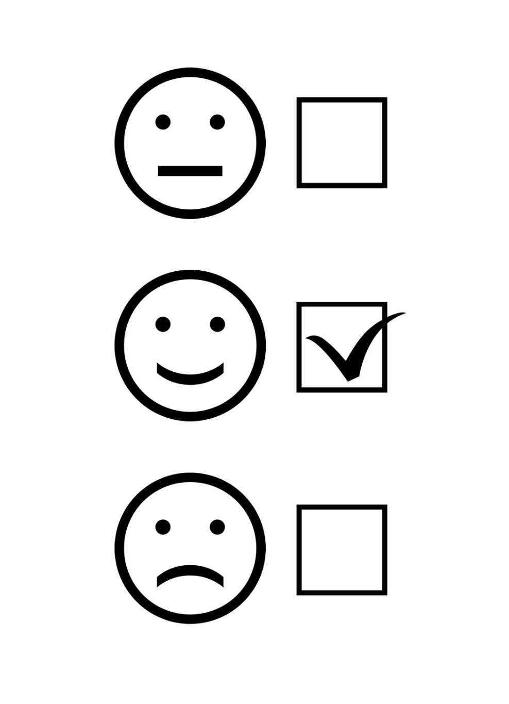
Monitoring and Evaluation Methods
Regular Feedback
Implementing regular feedback mechanisms ensures continuous improvement and assesses participant satisfaction with engagement initiatives.
Performance Metrics
Establishing clear performance metrics helps track the effectiveness of engagement initiatives over time.
Follow-up Surveys
Conducting follow-up surveys after initiatives provides insights into progress and long-term impact on participants.
Notes:
Monitoring and evaluation methods will be established to assess the effectiveness of the engagement initiatives. This includes regular feedback, performance metrics, and follow-up surveys to measure progress and impact.

Slide 15
Conclusion
Understanding Engagement Levels
Assessing current employee engagement levels is crucial for identifying areas for improvement and tailored initiatives.
Targeted Initiatives
Implementing targeted initiatives can significantly enhance employee satisfaction and commitment to the organization.
Monitoring Plan
Establishing a robust monitoring plan helps track engagement progress and adjust strategies as needed for continuous improvement.
Notes:
In conclusion, enhancing employee engagement at Adventure Works requires a multifaceted approach. By understanding current engagement levels, implementing targeted initiatives, and establishing a robust monitoring plan, we can create a more engaged and productive workforce.

